Slide 1

Note
Data can be corrupted during transmission.
Some applications require that errors be detected and corrected.

Slide 2
INTRODUCTION
some issues related, directly or indirectly, to error detection and correction.
Topics discussed in this section:
Types of Errors Redundancy Detection Versus Correction Forward Error Correction Versus Retransmission Coding
Modular Arithmetic

Slide 3
Note
In a single-bit error, only 1 bit in the data unit has changed.

Slide 4
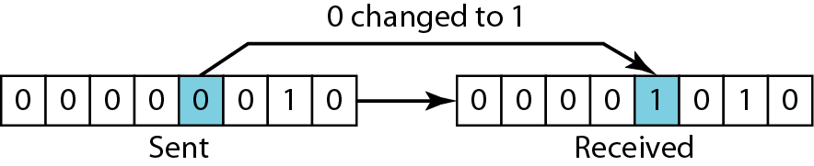
Figure 10.1 Single-bit error

Slide 5
Note
A burst error means that 2 or more bits in the data unit have changed.

Slide 6
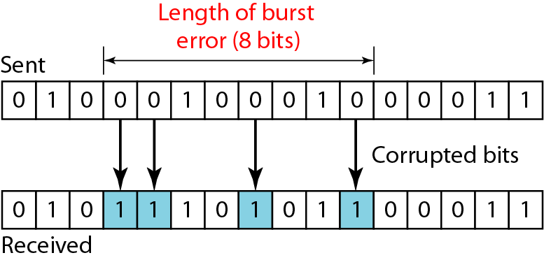
Figure 10.2 Burst error of length 8

Slide 7
Note
To detect or correct errors, we need to send extra (redundant) bits with data.

Slide 8
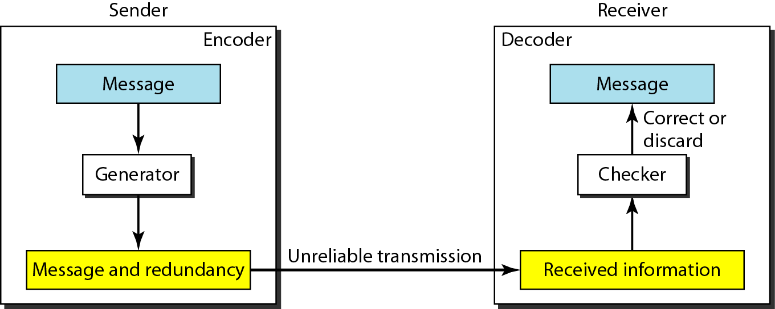
Figure 10.3 The structure of encoder and decoder

Slide 9
Note
we will concentrate on block codes; not on convolution codes .

Slide 10
Note
In modulo-N arithmetic, we use only the integers in the range 0 to N −1, inclusive.

Slide 11
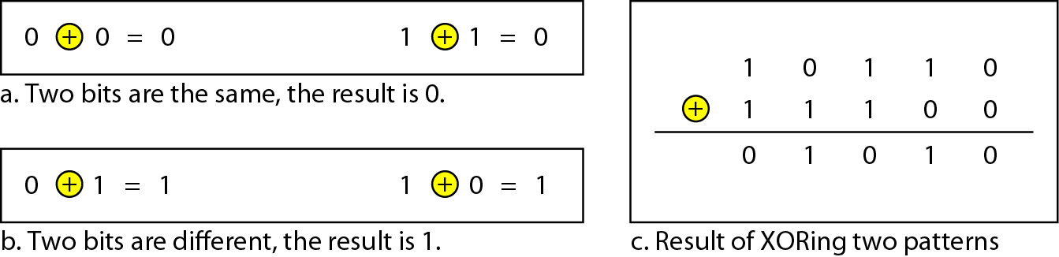
Figure 10.4 XORing of two single bits or two words

Slide 12
BLOCK CODING
In block coding, we divide our message into blocks, each of k bits, called datawords. We add r redundant bits to each block to make the length n = k + r. The resulting n-bit blocks are called codewords.
Topics discussed in this section:
Error Detection Error Correction Hamming Distance
Minimum Hamming Distance

Slide 13
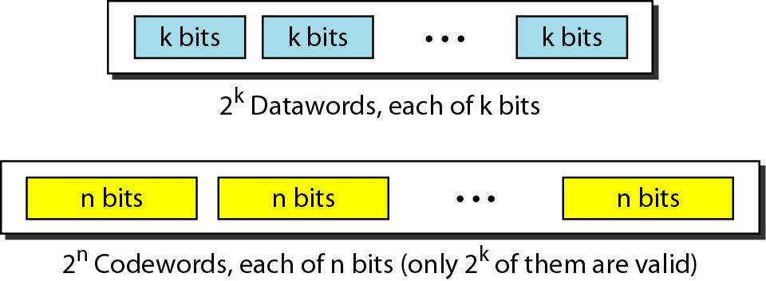
Figure 10.5 Datawords and codewords in block coding

Slide 14
Example 10.1
The 4B/5B block coding discussed in Chapter 4 is a good example of this type of coding. In this coding scheme, k = 4 and n = 5. As we saw, we have 2^{k} = 16 datawords and 2^{n} = 32 codewords. We saw that 16 out of 32 codewords are used for message transfer and the rest are either used for other purposes or unused.

Slide 15
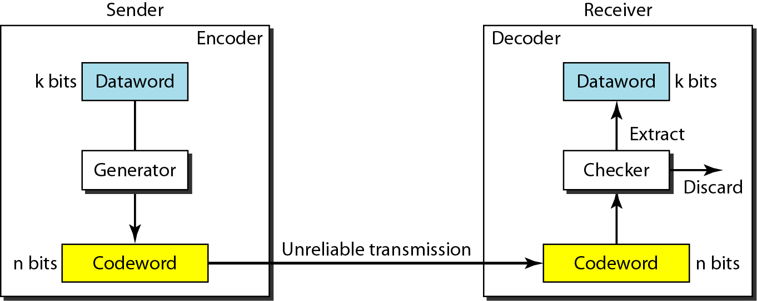
Figure 10.6 Process of error detection in block coding

Slide 16
Table 10.1 A code for error detection (Example 10.2)

Slide 17
Example 10.2
Let us assume that k = 2 and n = 3. Table 10.1 shows the list of datawords and codewords. Later, we will see how to derive a codeword from a dataword.
Assume the sender encodes the dataword 01 as 011 and
sends it to the receiver. Consider the following cases:
1. The receiver receives 011. It is a valid codeword. The receiver extracts the dataword 01 from it.

Slide 18
Example 10.2 (continued)
2. The codeword is corrupted during transmission, and 111 is received. This is not a valid codeword and is discarded.
3. The codeword is corrupted during transmission, and 000 is received. This is a valid codeword. The receiver incorrectly extracts the dataword 00. Two corrupted bits have made the error undetectable.

Slide 19
Note
An error-detecting code can detect only the types of errors for which it is designed; other types of errors may remain undetected.

Slide 20
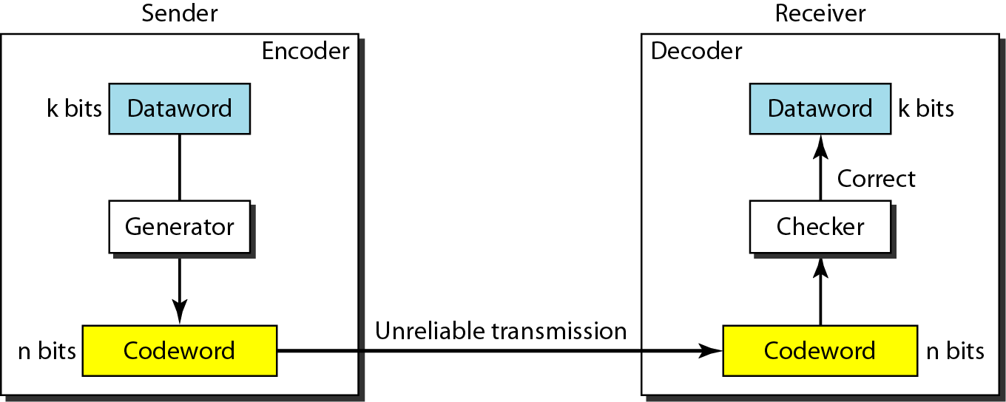
Figure 10.7 Structure of encoder and decoder in error correction

Slide 21
Example 10.3
Let us add more redundant bits to Example 10.2 to see if the receiver can correct an error without knowing what was actually sent. We add 3 redundant bits to the 2-bit dataword to make 5-bit codewords. Table 10.2 shows the datawords and codewords. Assume the dataword is 01. The sender creates the codeword 01011. The codeword is corrupted during transmission, and 01001 is received. First, the receiver finds that the received codeword is not in the table. This means an error has occurred. The receiver, assuming that there is only 1 bit corrupted, uses the following strategy to guess the correct dataword.

Slide 22
Example 10.3 (continued)
1. Comparing the received codeword with the first codeword in the table (01001 versus 00000), the receiver decides that the first codeword is not the one that was sent because there are two different bits.
2. By the same reasoning, the original codeword cannot be the third or fourth one in the table.
3. The original codeword must be the second one in the table because this is the only one that differs from the received codeword by 1 bit. The receiver replaces 01001 with 01011 and consults the table to find the dataword 01.

Slide 23
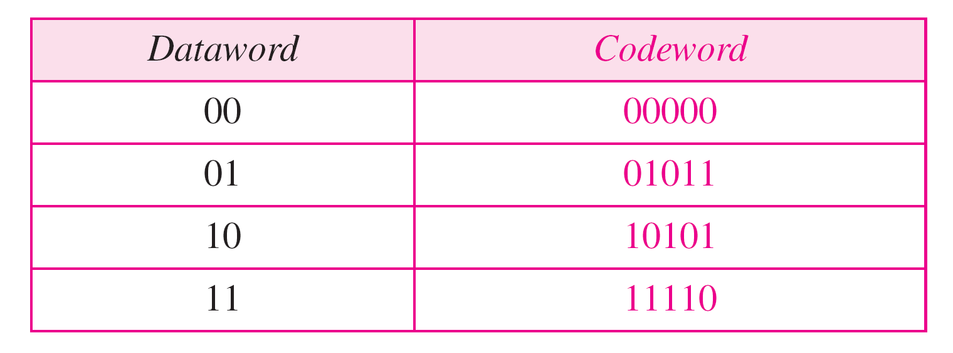
Table 10.2 A code for error correction (Example 10.3)

Slide 24
Note
The Hamming distance between two words is the number of differences between corresponding bits.

Slide 25
Example 10.4
Let us find the Hamming distance between two pairs of words.
1. The Hamming distance d(000, 011) is 2 because
2. The Hamming distance d(10101, 11110) is 3 because

Slide 26
Note
The minimum Hamming distance is the smallest Hamming distance between all possible pairs in a set of words.

Slide 27
Example 10.5
Find the minimum Hamming distance of the coding scheme in Table 10.1.
Solution
We first find all Hamming distances.
The d_{min} in this case is 2.

Slide 28
Example 10.6
Find the minimum Hamming distance of the coding scheme in Table 10.2.
Solution
We first find all the Hamming distances.
The d_{min} in this case is 3.

Slide 29
Note
To guarantee the detection of up to s errors in all cases, the minimum
Hamming distance in a block code must be d_{min} = s + 1.

Slide 30
Table 10.1 A code for error detection (Example 10.2)

Slide 31
Example 10.7
The minimum Hamming distance for our first code scheme (Table 10.1) is 2. This code guarantees detection of only a single error. For example, if the third codeword (101) is sent and one error occurs, the received codeword does not match any valid codeword. If two errors occur, however, the received codeword may match a valid codeword and the errors are not detected.

Slide 32
Example 10.8
Our second block code scheme (Table 10.2) has d_{min} = 3. This code can detect up to two errors. Again, we see that when any of the valid codewords is sent, two errors create a codeword which is not in the table of valid codewords. The receiver cannot be fooled.
However, some combinations of three errors change a valid codeword to another valid codeword. The receiver accepts the received codeword and the errors are undetected.

Slide 33
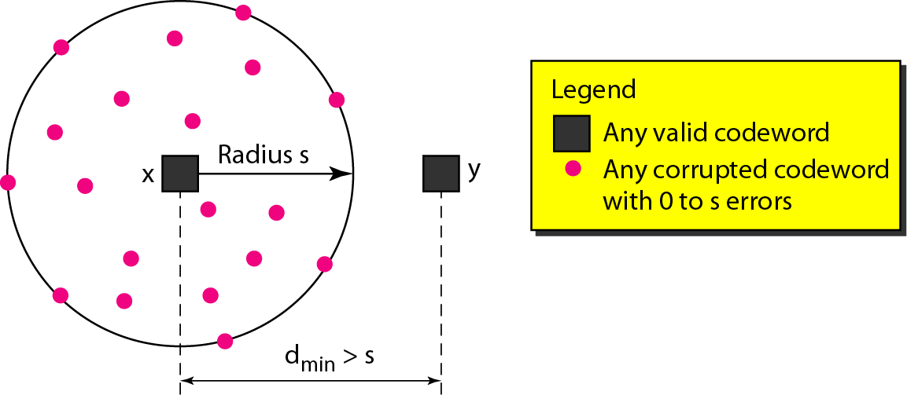
Figure 10.8 Geometric concept for finding d_{min} in error detection

Slide 34
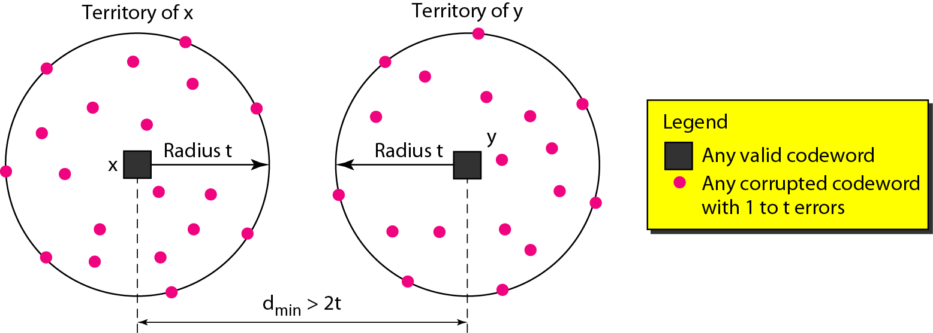
Figure 10.9 Geometric concept for finding d_{min} in error correction

Slide 35
Note
To guarantee correction of up to t errors in all cases, the minimum Hamming distance in a block code must be d_{min} = 2t + 1.

Slide 36
Example 10.9
A code scheme has a Hamming distance d_{min} = 4. What is the error detection and correction capability of this scheme?
Solution
This code guarantees the detection of up to three errors (s = 3), but it can correct up to one error. In other words, if this code is used for error correction, part of its capability is wasted. Error correction codes need to have an odd minimum distance (3, 5, 7, . . . ).

